Slide 1
Radio Transmission & RF Modulation
Archie Stinks
By Archie Casemeister, Fergus Schofield and Riley Havill

Slide 2
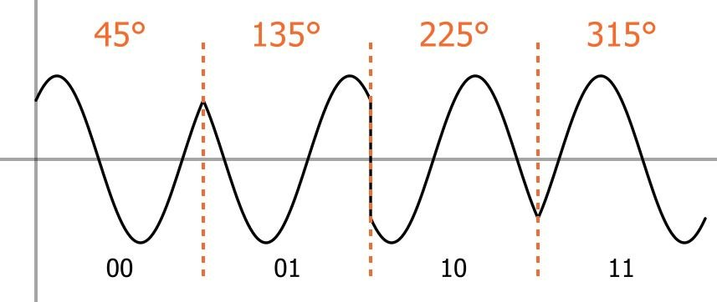
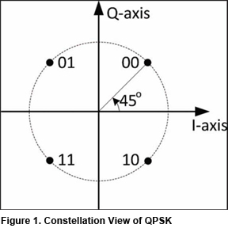
Quadrature Phase Shift Keying

Slide 3
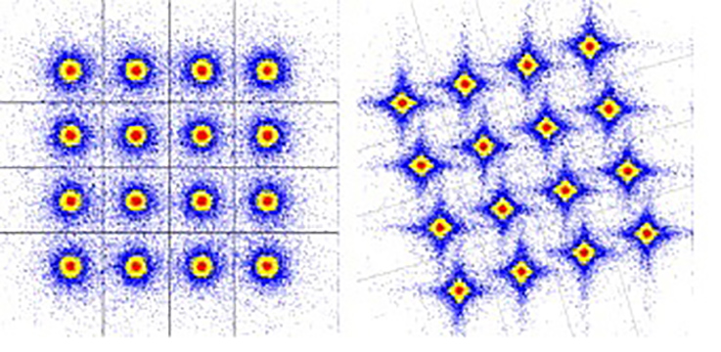
Quadature Amplitude Modulation

Slide 4
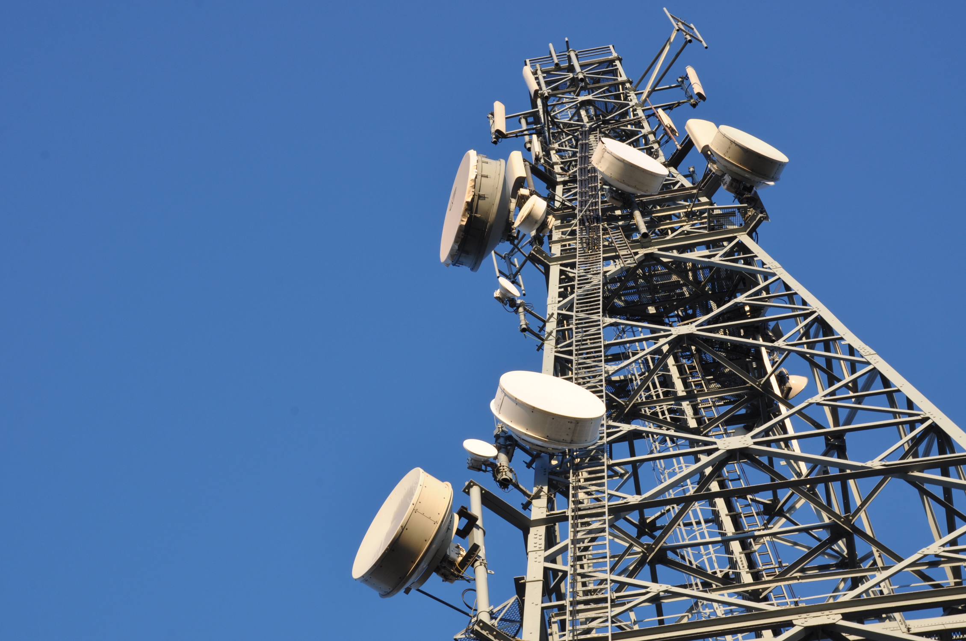
Radio Transmission Stations
Notes:
These contain a variety of different type of equipment all doing separate jobs that enable radio stations to send information along specific radio frequencies. They are found all over the UK and play a big part in peoples day to day lives.

Slide 5
The first half of the process
Notes:
Once the signal enters the transmission station from the studio it is first met by a codec. This device encodes and decodes from analog to digital. It then is passed into a processor such as a VOLT. This can evaluate certain features of the audio and alter it to the desired performance. For example it can make a sound more punchy for rock, however for classical it may want to be smoother. RDS encoder, this adds info such as name of the artist and specific info for the area

Slide 6
The Second Half Of The Process
Notes:
After the Processor, the signal is put into a exciter which generates the modulated waveform that can be radiated from the antenna and received by a radio receiver. After this the signal goes through an amplifier which boosts/ increases the power of the signal at the bottom of the antenna.

Slide 7
Telemetry
What is telemetry?
How is it used here?
Notes:
Telemetry is what is used to monitor the systems, a program called Mimic monitors every station and makes it easy to see when a certain part of the broadcast chain is down. When part of the system is down, this program makes it very easy to change to a backup system with just a few clicks. Arqiva's Emley Moor station is where the main telemetry happens.

Slide 8
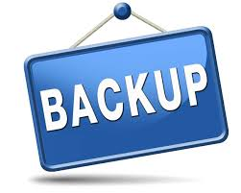
Resilience
Notes:
Some stations want to have more resilience, which means that if the signal drops there is back up. There are a few ways of doing this. There are some forms of technology that help this process. RB sd1 This detects silence in a signal, when this happens in can switch it to a backup or can switch to an MP3. These provides a back up sound that can then be sent straight to the processor. When company's want to include these forms of backup they need to think about cost. Obviously having double equipment or different equipment is going to cost a lot. Resilience is extremely important as you can imagine as for every second a signal is down company's can lose thousands.

Slide 9

Thank you

